Slide 1
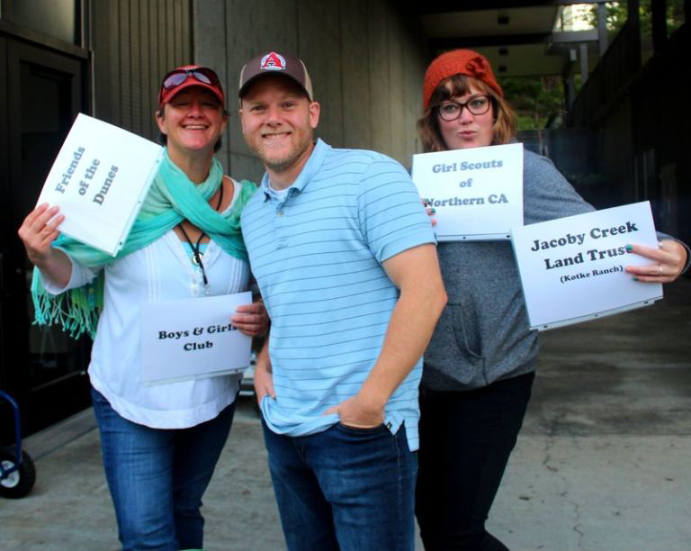
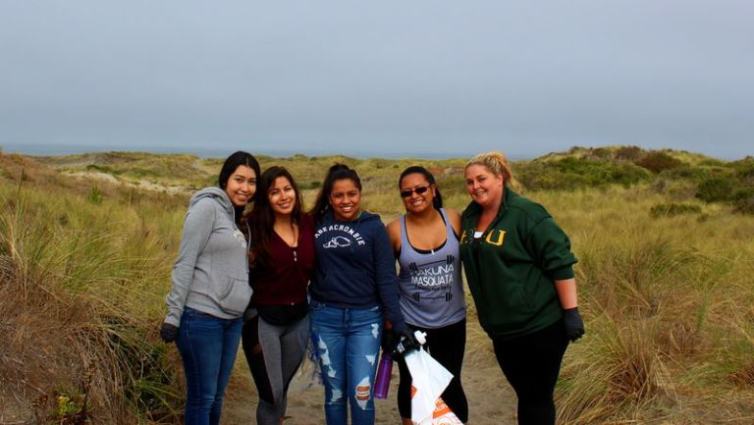
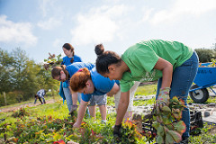
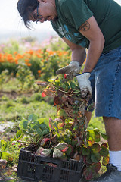
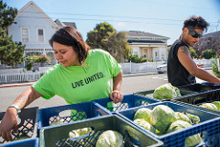
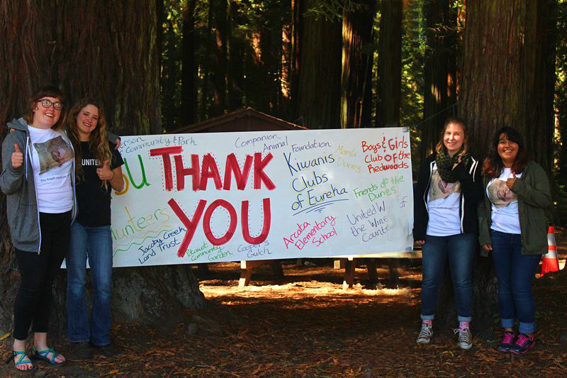
Day Of Caring 2015 Center For Service Learning and Academic Internships
What is Day of Caring?
Where we went:
Day Of Caring is an event that aims to give HSU students the opportunity to get involved and make a difference in their community. We team up with over a dozen different amazing organizations that could use volunteer help for a project.
Total Students at event: 140
Total Active Sites: 15
Arcata Elementary School
Arcata Marsh & Wildlife Sanctuary
Boys & Girls Club of the Redwoods
Companion Animal Foundation
Food for People
Friends of the Dunes
Girls Scouts of Northern California
Jacoby Creek Land Trust
Jefferson Community Center & Park
Potawot Community Garden
The RAVEN Project
Zero Waste Humboldt- North Coutnry Fair
CA Coastal Cleanup- Manilla Dunes
CA Coastal cleanup- Cooper Gulch
I was the lead at the park clean up which was a fun opportunity to meet new people and be outside! Being a part of Day of Caring, I got to learn so much about what goes into a volunteer event and specifically a park clean up.
CA Coastal Cleanup- Eureka Waterfront
Thank You to everyone who made this event such a success! Keep an eye out for us again in September!
Testimonials
“The day of caring was a fun way to give back to the community and meet new people. It was my first time going to that park and I was glad for the opportunity to help clean it up! Volunteering was definitely a cool way to discover more of Humboldt and made me feel more connected to this area” – Mary McDermott
“Day of caring really helped me feel like I made a difference in our community. I look forward to having more opportunities which can have a positive impact on our environment” – Morgan Strite

