Slide 1
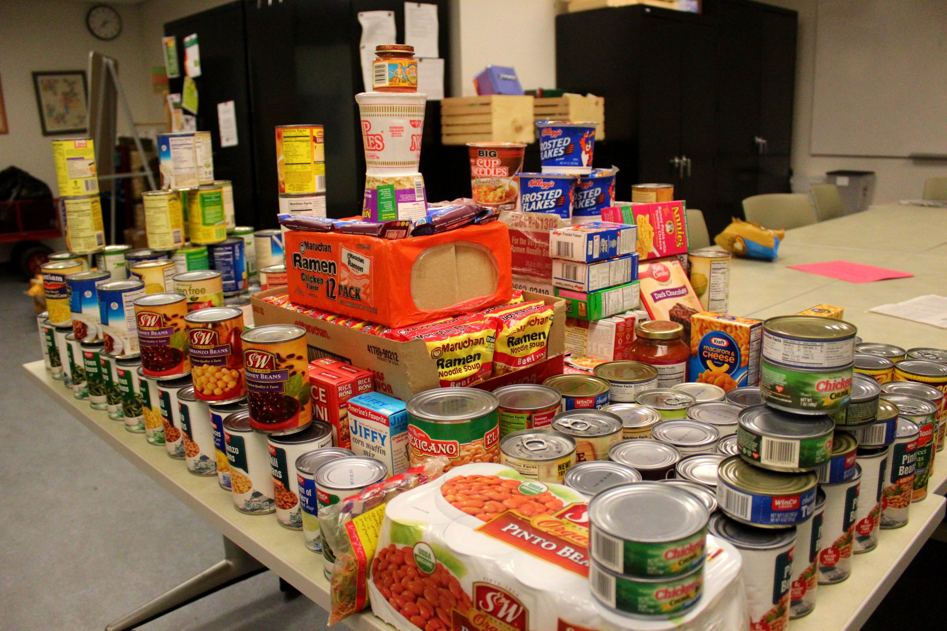
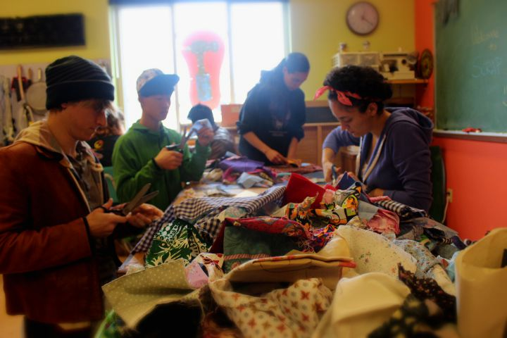
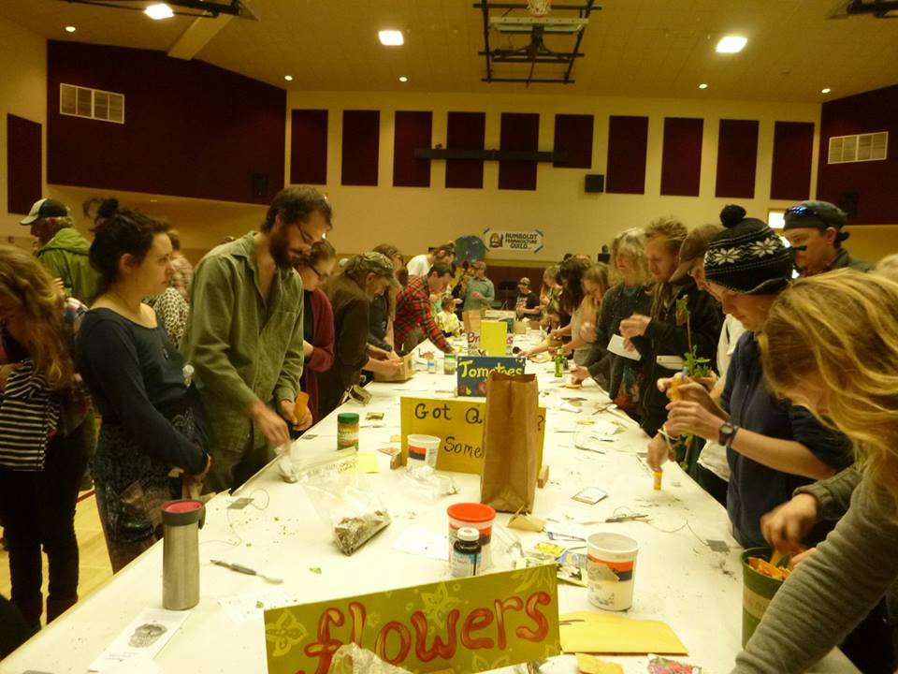
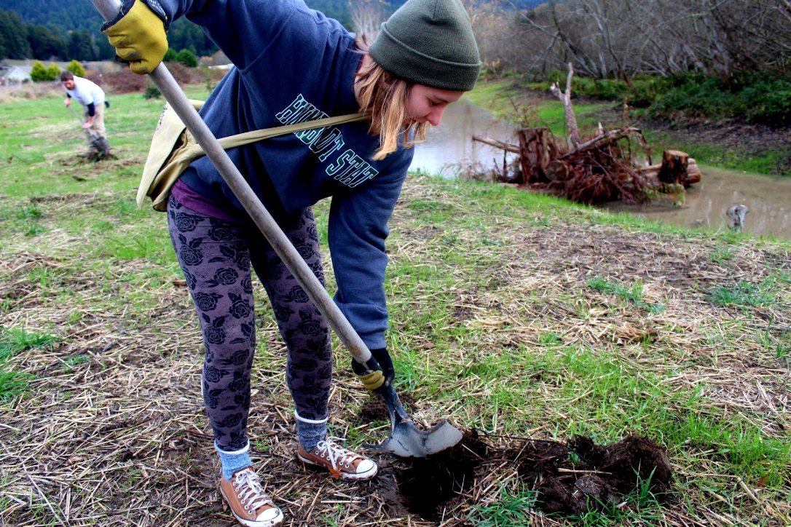
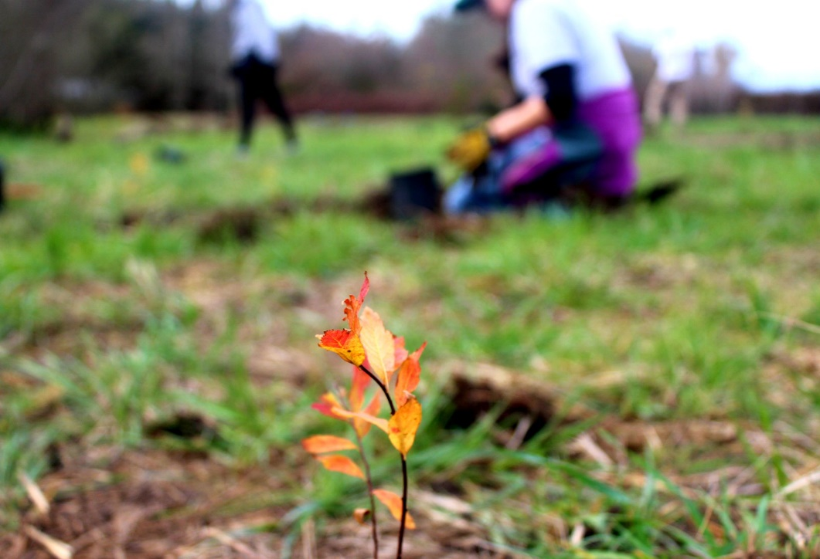
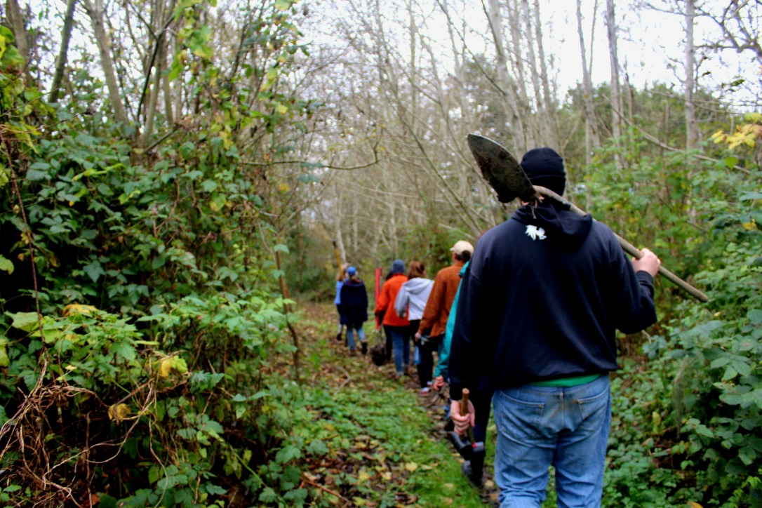
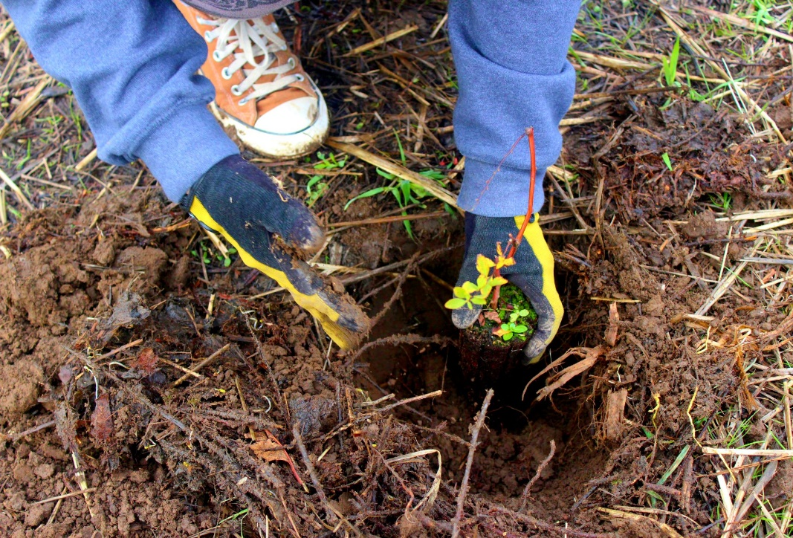
Center for Service Learning and Academic Internships:
The Volunteer Opportunity Program
Our Mission
Club Contest
SCRAP Humboldt
Seed and Plant Exchange
Promoting HSU's vision to serve students "who seek above all else to improve the human condition and our environment.“ We host various community service events throughout the academic year to help serve the local community!
In February, we co-hosted a volunteer event with local non-profit SCRAP Humboldt, who works to reduce waste and creates crafts for purchase. Students created collage packets, banner flag kits, and reorganized their stock.
In March, we volunteered at the Humboldt Permaculture Guild’s Annual Seed and Plant Exchange. Volunteers helped with the info desk, operating the live plant and seed tables, and even kitchen help for this big event!
Our Center Hosted a Community Food drive and raised 2 barrels of food donated to local nonprofit Food for People for the community members. We also had a club contest at HSU and donated 2 full barrels to HSU Food Pantry for students to use. In total, we had a record breaking amount of 850 pounds of food donated!
Jacoby Land Creek Trust
In December, we brought students to the Jacoby Land Creek Trust to plant native trees and the removal of invasive plants. We planted over 30 new trees around the creek. These new trees will help the restoration of Salmon in the creeks later on!
Leadership Experience
“Working on the Volunteer Opportunity Program helped me grow closer to the community I served and allowed me to see the immediate impact of what I can do while helping others.”
- Jessica Garcia, a Community Engagement Intern
Our Next V.O.P.
We are volunteering for Party for the Planet Celebration at the Sequoia Park Zoo this Sunday!

